Slide 1

FINANCIAL ENGINEERING PROJECT Stage 2
POZNAN UNIVERSITY OF ECONOMICS AND BUSINESS
Students:
Tu Anh Nguyen
Thi Kim Phuong Nguyen
Askar Mulkubayev
Osborn Mugaviri

Slide 2

Content
CDS spread
CIR model calibration
Hazard rate simulation

Slide 3


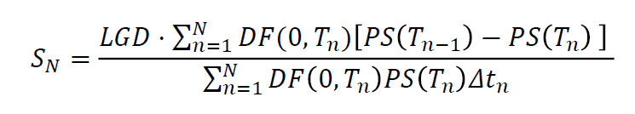
I. Credit Default Swap
Mechanic – CDS spread
Premium Leg
CDS buyer
CDS seller
Default Leg
NPV of Premium Leg = NPV of Default Leg
CDS
Notes:
A credit default swap (CDS) is a financial swap agreement that the seller of the CDS will compensate the buyer in the event of a debt default (by the debtor) or other credit event.[1] That is, the seller of the CDS insures the buyer against some reference asset defaulting. The buyer of the CDS makes a series of payments (the CDS "fee" or "spread") to the seller and, in exchange, may expect to receive a payoff if the asset defaults.
In the CDs inception: NPV of Premium Leg = NPV of Default Leg. => we have formula to calculate CDS spread
In this stage of project, our target is to imply the probability by default from a CDS spread, which already given from market data, by CIR calibration

Slide 4





II. CIR model
𝜆(𝑡) - The value of Hazard rate at time t 𝜇 - The long term mean 𝜎 - The volatility 𝑑𝑊(𝑡)-standard Brownian Motion
Notes:
K is the long term mean reversion coefficient
The standard deviation factor, sigma*sqrt(lambda) avoids the possibility of negative interest rates for all positive values of a and b. An interest rate of zero is also precluded if the condition 2ab>=singma^2 is met. More generally, when the rate ({\displaystyle r_{t}}) is close to zero, the standard deviation ({\displaystyle \sigma {\sqrt {r_{t}}}}) also becomes very small, which dampens the effect of the random shock on the rate. Consequently, when the rate gets close to zero, its evolution becomes dominated by the drift factor, which pushes the rate upwards.
More generally, when the rate is close to zero, the standard deviation sigma*sqrt(lambda) also becomes very small, which dampens the effect of the random shock on the rate. Consequently, when the rate gets close to zero, its evolution becomes dominated by the drift factor, which pushes the rate upwards

Slide 5

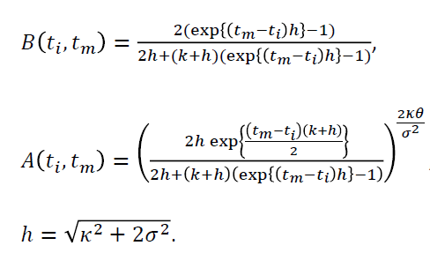
At time t_{i}, PS(0,T) can be calculated:

Slide 6
CIR Calibration
Residual (y*-y)²
Tenor | CDS Spread | CDS spread from model | Target function
6 | 35.88 | 32 | 14
12 | 39.40 | 45 | 40
24 | 69.35 | 70 | 1
36 | 96.70 | 95 | 3
48 | 123.33 | 121 | 5
60 | 152.07 | 153 | 1
Excel Solver
Minimize sum of Residual
By changing model parameters
kappa | 0.4961
mu | 0.0168
sigma | 0.1289
lambda(0) | 0.0059
h | 0.5285
Notes:
Page 35-36

Slide 7

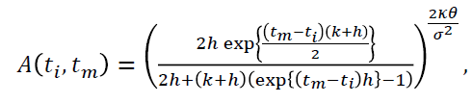
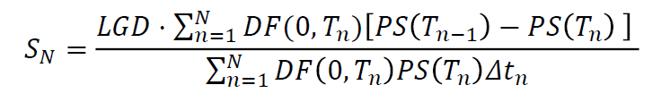


Probability of Default
kappa | 0.4961
mu | 0.0168
sigma | 0.1289
lambda(0) | 0.0059
h | 0.5285
Discounted factor (r = 2%)
Tenor |  | T | ΔT | DF | A(0,T) | B(0,T) | PS(0,T) | PD(t,T) | CDS spread
0 |  | 0.00 |  | 1.0000 | 1.0000 | 0.0000 | 1.0000
1 |  | 0.25 | 0.25 | 0.9950 | 0.9998 | 0.1634 | 0.9988 | 0.1181%
2 | 6 months | 0.50 | 0.25 | 0.9900 | 0.9991 | 0.3511 | 0.9970 | 0.1775% | 31.98
3 |  | 0.76 | 0.26 | 0.9849 | 0.9979 | 0.5670 | 0.9947 | 0.2349%
4 | 1 year | 1.02 | 0.26 | 0.9798 | 0.9964 | 0.8184 | 0.9918 | 0.2943% | 45.44
8 | 2 years | 2.03 | 0.25 | 0.9602 | 0.9878 | 2.1734 | 0.9755 | 0.4754% | 70.23
12 | 3 years | 3.04 | 0.26 | 0.9409 | 0.9762 | 4.4330 | 0.9516 | 0.6804% | 95.19
16 | 4 years | 4.06 | 0.26 | 0.9220 | 0.9628 | 8.1867 | 0.9186 | 0.9334% | 121.42
20 | 5 years | 5.07 | 0.26 | 0.9035 | 0.9486 | 14.4162 | 0.8731 | 1.2877% | 153.14

Slide 8
Probability of Default
CDS increases
Credit risk increase
Probability by default increase
Tenor |  | T | ΔT | DF | A(0,T) | B(0,T) | PS(0,T) | PD(t,T) | CDS spread
0 |  | 0.00 |  | 1.0000 | 1.0000 | 0.0000 | 1.0000
1 |  | 0.25 | 0.25 | 0.9950 | 0.9998 | 0.1634 | 0.9988 | 0.1181%
2 | 6 months | 0.50 | 0.25 | 0.9900 | 0.9991 | 0.3511 | 0.9970 | 0.1775% | 31.98
3 |  | 0.76 | 0.26 | 0.9849 | 0.9979 | 0.5670 | 0.9947 | 0.2349%
4 | 1 year | 1.02 | 0.26 | 0.9798 | 0.9964 | 0.8184 | 0.9918 | 0.2943% | 45.44
8 | 2 years | 2.03 | 0.25 | 0.9602 | 0.9878 | 2.1734 | 0.9755 | 0.4754% | 70.23
12 | 3 years | 3.04 | 0.26 | 0.9409 | 0.9762 | 4.4330 | 0.9516 | 0.6804% | 95.19
16 | 4 years | 4.06 | 0.26 | 0.9220 | 0.9628 | 8.1867 | 0.9186 | 0.9334% | 121.42
20 | 5 years | 5.07 | 0.26 | 0.9035 | 0.9486 | 14.4162 | 0.8731 | 1.2877% | 153.14
Notes:
In fact, the CDS spread should give a measure of credit risk, expressed by the probability of default.
cds increase => risk increase => prob by default increase

Slide 9
Hazard Rate Simulation.
Hazard rate also known as the instantaneous incident rate or default intensity is a theoretical measure of the probability of occurrence of an even per unit time at risk.
In this scenario, it is the probability of default on the option. On CDS, one party agrees to buy protection and provides regular payment until the credit event occurs or at maturity of the contract.
Banks or Insurance companies are normally the sellers and will assume credit risk.

Slide 10
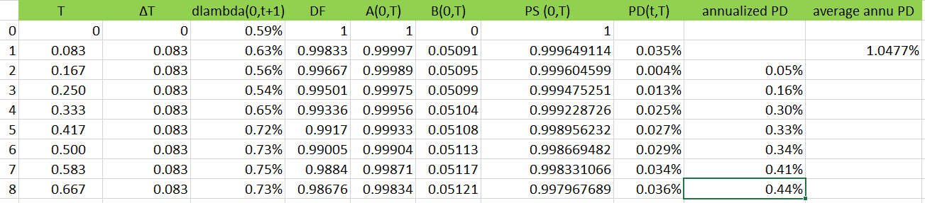
Graphical view
We Simulate using the above parameters. The graph represents 60 1 month periods where the values tend to draw towards the Long term mean of around 1.68%

Slide 11
Parameters explained.
kappa | 0.4961
mu | 0.0168
sigma | 0.1289
lambda(0) | 0.0059
h | 0.5285
Feller condition | 0.0000
Mean μ =is the long term mean
dt = discrete drift
Sigma σ = the continuous volatility.
Lambda λ = the value of hazard rate at time t
Kappa k = the speed of reversion that is the speed or rate at which the hazard rate moves towards Lambda.

Slide 12
Hazard rate
The results from our simulation shows quite a number of negative values for the Hazard rate.
Imposing the Feller condition on the parameter space guarantees that the volatility will not drop below infinity levels.
Negative hazard rate normally occurs where there is negative volatility. The implied volatility of an option is technically able to be negative only if the option sellers are willing to sell the options with the more negative expected return than the market interest rate.
Since volatility is defined as the square root of variance and the square root has two possible solutions, a positive and a negative. Thus, the negative solution is as possible as the positive one, and both of them result positive variance when squared.

Slide 13
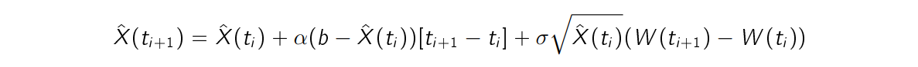
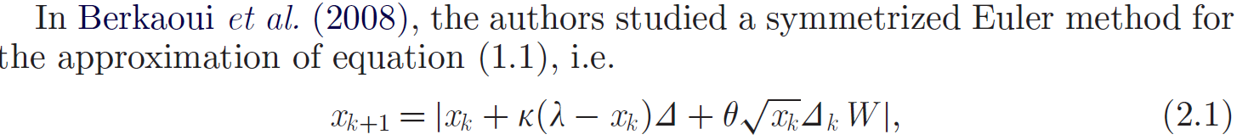
Imposing Positivity on Hazard Rate
Consider the following most straightforward Euler scheme on the time interval [0,T] for a CIR process X(t)

Slide 14
Thank you for listening!

